Slide 1













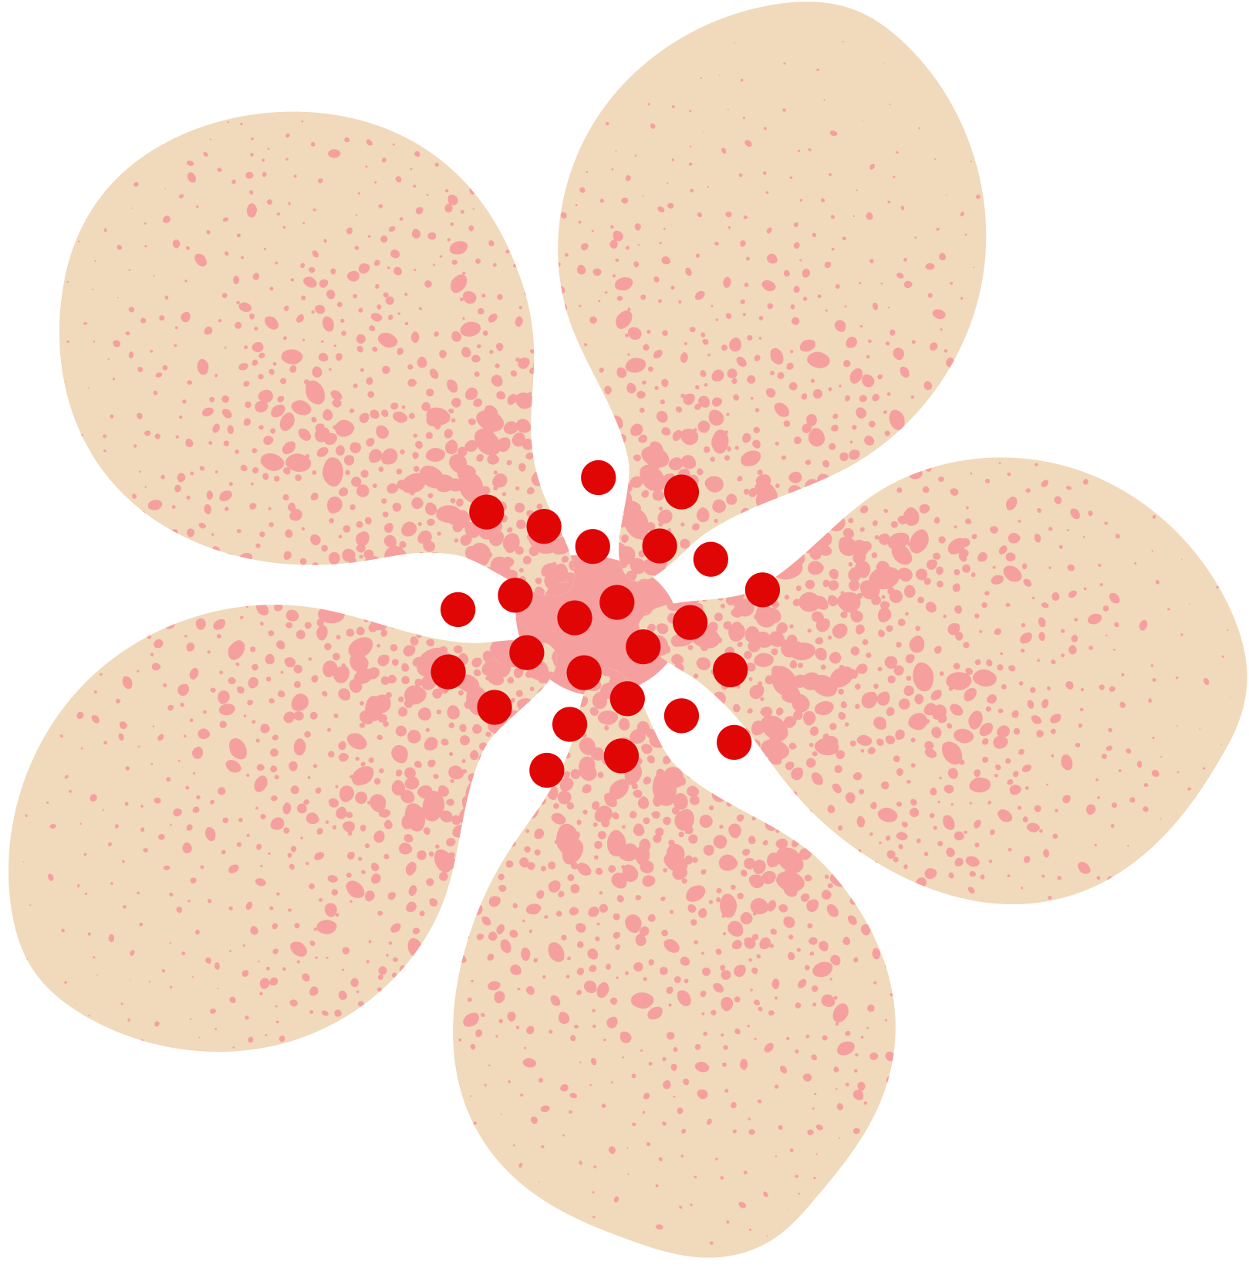


















April
2025
Spring
Into action
SUNDAY | MONDAY | TUESDAY | WEDNESDAY | THURSDAY | FRIDAY | SATURDAY
 |  | 1 | 2 | 3 | 4 | 5
6 | 7 | 8 | 9 | 10 | 11 | 12
13 | 14 | 15 | 16 | 17 | 18 | 19
20 | 21 | 22 | 23 | 24 | 25 | 26
27 | 28 | 29 | 30
  Site Mental Health Kick off 5-8pm
  Digital Literacy for Adults Part II; 1-3pm
Lead: Alaina
  Spring Break Begins
  Spring Break Camp Begins
  Teen Movie Night!
Boys & Girls 13 & up
6-8pm
  Camp Field Trip 11-3pm
  Spring Break Camp Ends
  Spring Break Ends
  Bingo World for Adults; 11-3pm
Lead: Alaina
2314 E. Joppa Road
2nd Floor
Parkville, MD 21234

